Slide 1
ONBOARDING RESEARCH LIBRARIES TO CITIZEN SCIENCE: HOW CAN WE ACT? A FUTURES WORKSHOP
Darlene Cavalier (Arizona State University)
Karen Ciccone (NC State University Libraries)
Anne Kathrine Overgaard (SDU Health Sciences)
Thomas Kaarsted (SDU Library)
27. May 2025

Slide 2
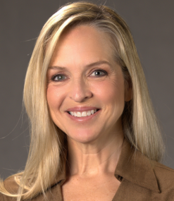
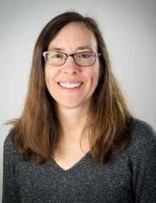
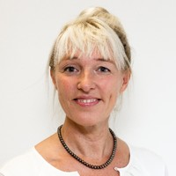
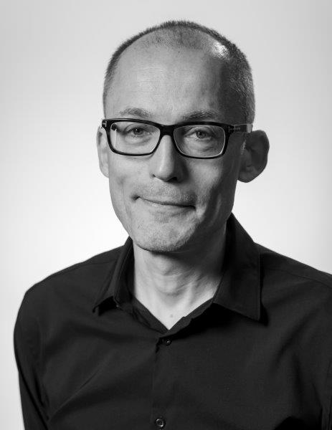
Who are we?
Darlene Cavalier darcav1@gmail.com
Professor of Practice, Arizona State University
Founder of Scistarter.org
“Citizen Science is Big Serious Science”
Karen Ciccone: kacollin@ncsu.edu
Lead Librarian for Public Science
NC State University Libraries
“Citizen Science, Open Research, Digital Scholarship, Public Engagement”
Anne Kathrine Overgaard: ako@sdu.dk
Head of Research Support and Innovation, SDU Health Science
Co-founder of SDU Citizen Science Knowledge Center
“Combining Citizen Science and Innovation in research”
Thomas Kaarsted: thk@bib.sdu.dk
Deputy Library Director, SDU Library
Co-founder of SDU Citizen Science Knowledge Center
“Daily manager of Citizen Science at SDU Library. Connecting researchers with the public”

Slide 3
Today’s programme (1st part)
Welcome and Icebreaker
What is Citizen Science to you?
What is your (best) experience with Citizen Science?
Three short presentation
Darlene Cavalier: Citizen Science is Big Serious Science
Karen Ciccone: Citizen Science at NC State
Anne Kathrine Overgaard & Thomas Kaarsted:
Why Research Libraries as ‘Hubs’ for Citizen Science Matter
Short dialogue + Break

Slide 4
Today’s programme (2nd part)
A FUTURES WORKSHOP – LIGHT VERSION
Mapping of steps in Citizen Science: Which steps in the research process can libraries etc. aid researcher's and the public
Identifying barriers and accelerators: Which pros and con’s can we identify together
Participants advice for the future: How can we act? Shared future statement on the role of hubs in Citizen Science.

Slide 5
Icebreaker
What is Citizen Science to you?
What is your (best) experience with Citizen Science?

Slide 6
Notes:
Think about the many terms used when you search for literature. They might not be completely correct, but if they are used commonly in certain fields, they might be relevant.
Patient engagement used at the Health faculty at SDU.
People-powered research (Zooniverse).

Slide 7
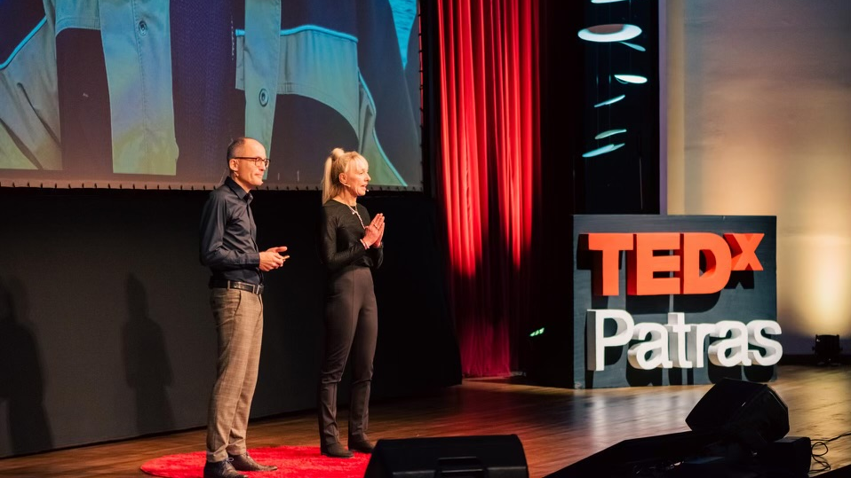
Why Research Libraries as ‘Hubs’ for Citizen Science Matter

Slide 8
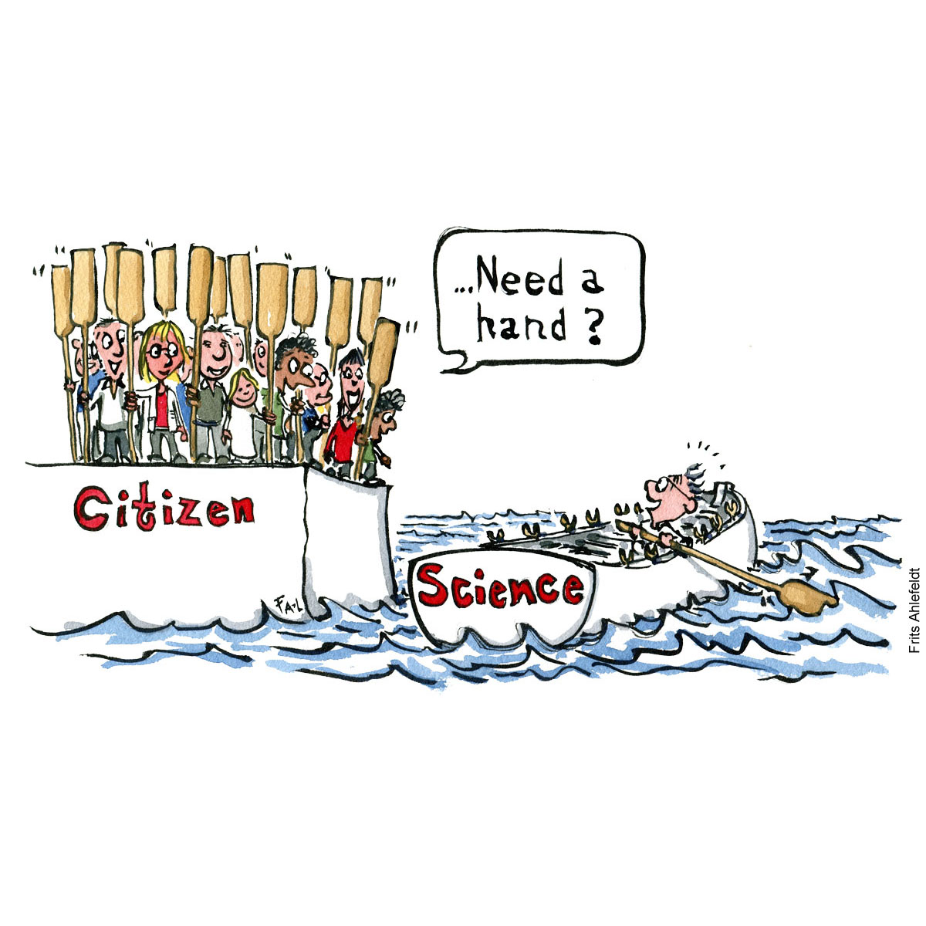
Why Citizen Science
Drawings by Frits Ahlefeldt

Slide 9
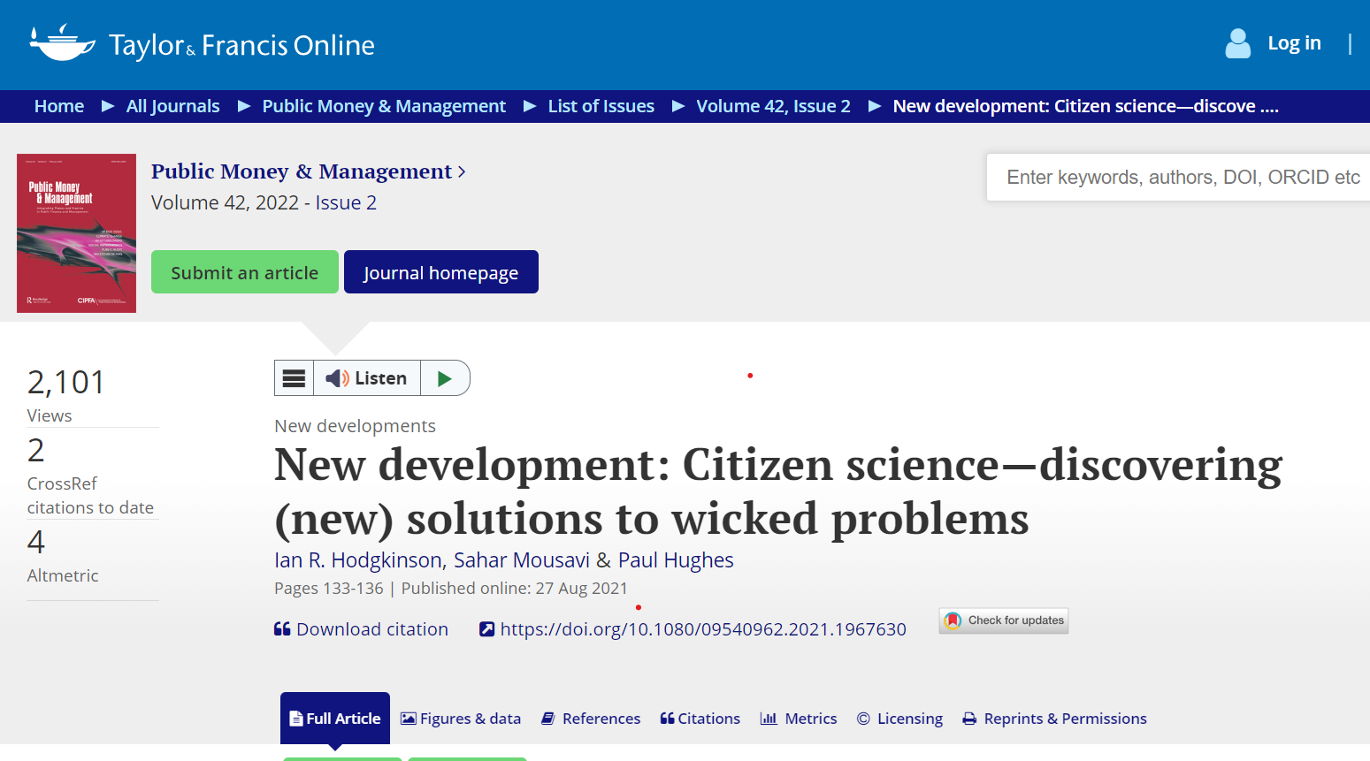
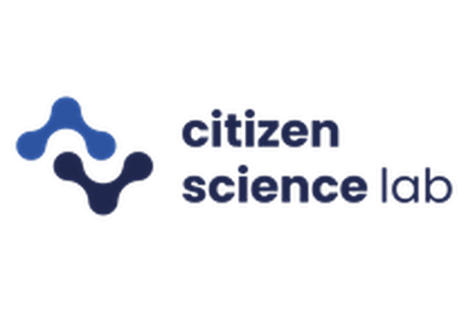
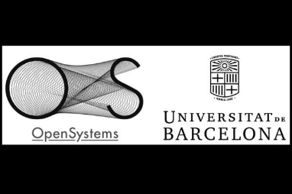

Slide 10
What is societal impact??
‘Societal impact refers to the ways in which research contributes to developments in society and research can have impact in society in many ways.’

Slide 11
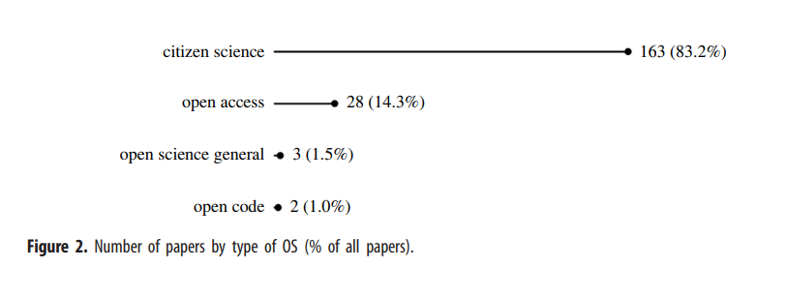
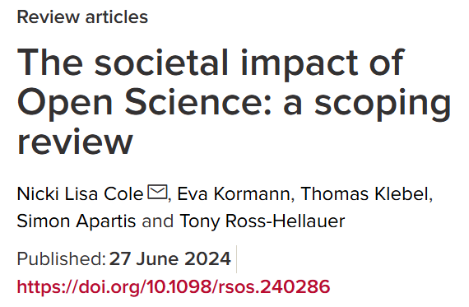
Connection between Open Science, Citizen Science and Societal Impact

Slide 12
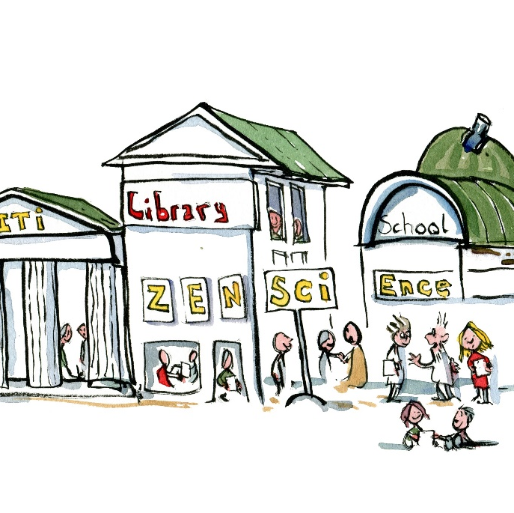
Why research libraries?

Slide 13
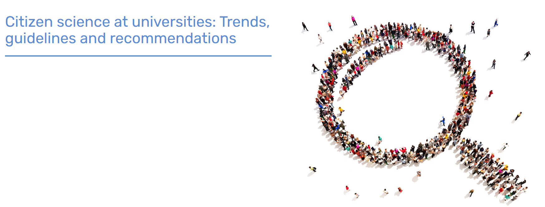
”Wherever viable research institutions should establish a hub or single point of contact for Citizen Science.” (LERU 2016)

Slide 14
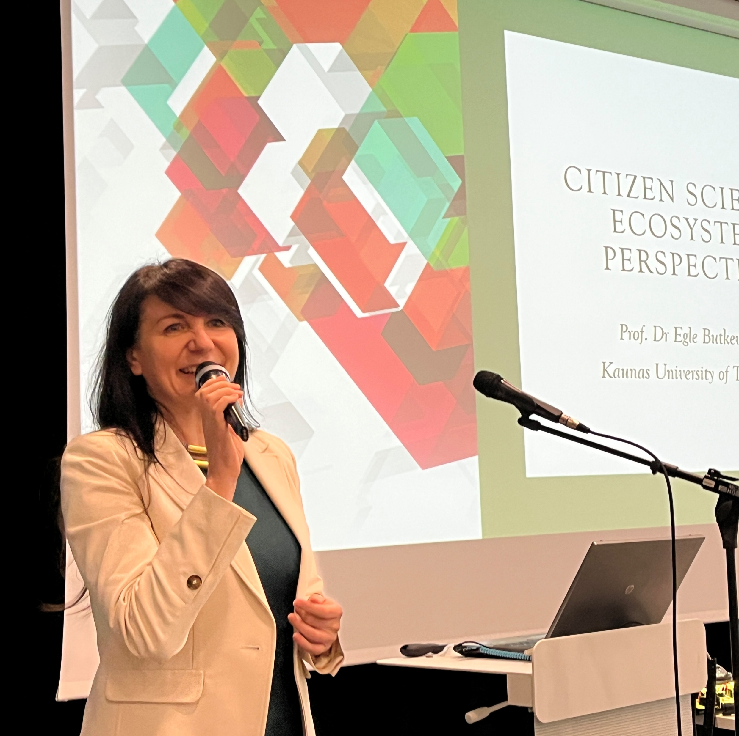
Roles and responsibilities of researchers in Citizen Science
INITIATOR
FACILITATOR
COMMUNICATOR
MEDIATOR
OBSERVER
EDUCATOR
Notes:
Forskerens udvidede rolle i CS. Videncenteret assisterer. Modus 2 forskning, Anvendelsesperspektiv. Bidrage konstruktivt til samfundets udvikling.
CS: Projekter hvor frivillige samarbejder med forskere om at besvare virkeligheds-relevante spørgsmål.
Vilde problemer kan give frygt/modstand/håbløshed – også via mediedækningen. Kan det imødegås ved involvering og engagement?
Både store spørgsmål og i mindre skala. CS på SDU på alle fakulteter, mange fagdiscipliner.
Unikt på SDU, at vi arbejder så meget med mediesamarbejder, ikke nødvendigvis en integreret del af int. CS-teorier og CS-projekter. Ikke løst endnu, men vi arbejder på det – asfalterer mens vi kører.
Coloumbic-modellens øverste linje beskriver CS-teoriens tilgang, næste linje er vores praksistilgang fra forskningssiden –
sidste linje er hensigten – IKKE blot på forskningens vegne, men også på mediernes og borgernes vegne. Mere involvering, tættere på hinanden borgere, journalister, forskere.

Slide 15
Skills in Citizen Science
Advocacy
Project coordination
Project management
Arranging events
Facilitation of workshops
Teaching
Evaluation
Writing or assisting in grant proposals
Communication incl. SoMe, web, posters, flyers etc.
Research data management
Publication of FAIR data
GDPR
Societal impact
Sources: Built to Last, Ignat & Ayris (2020), LIBER Open Science Roadmap (2018), Citizen Science i Danmark (2020) Kaarsted et al. (2023).

Slide 16
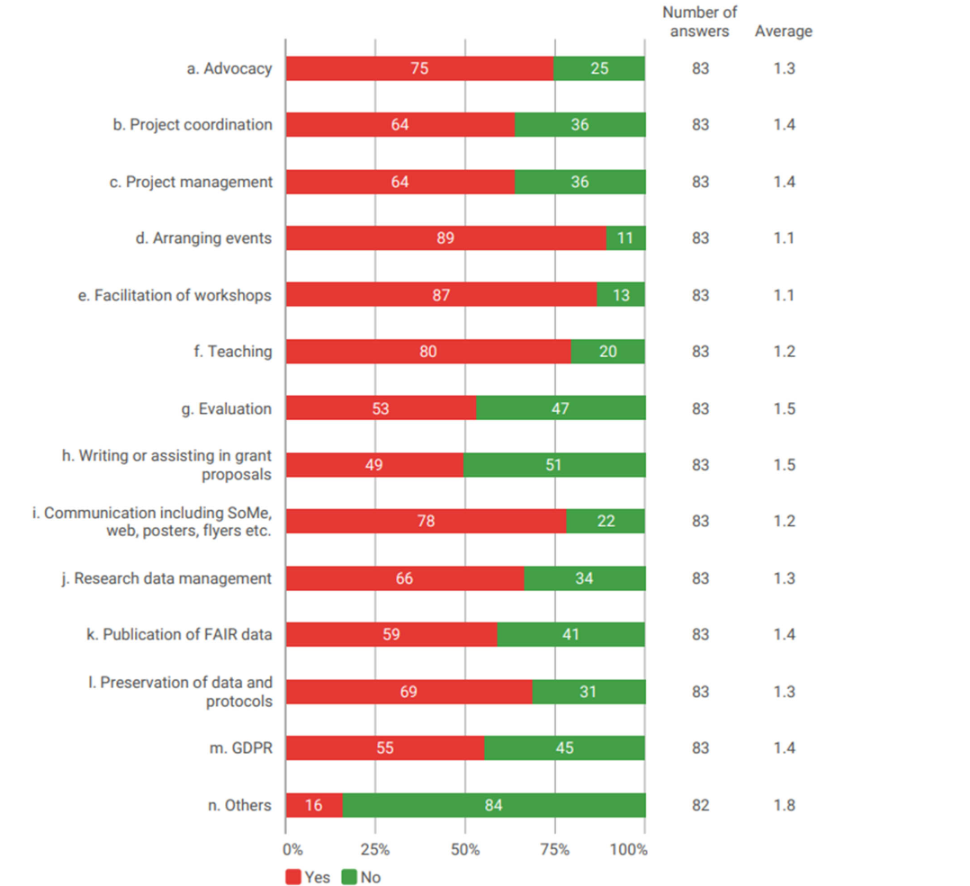
Reported skills
E European research
libraries (2023)

Slide 17
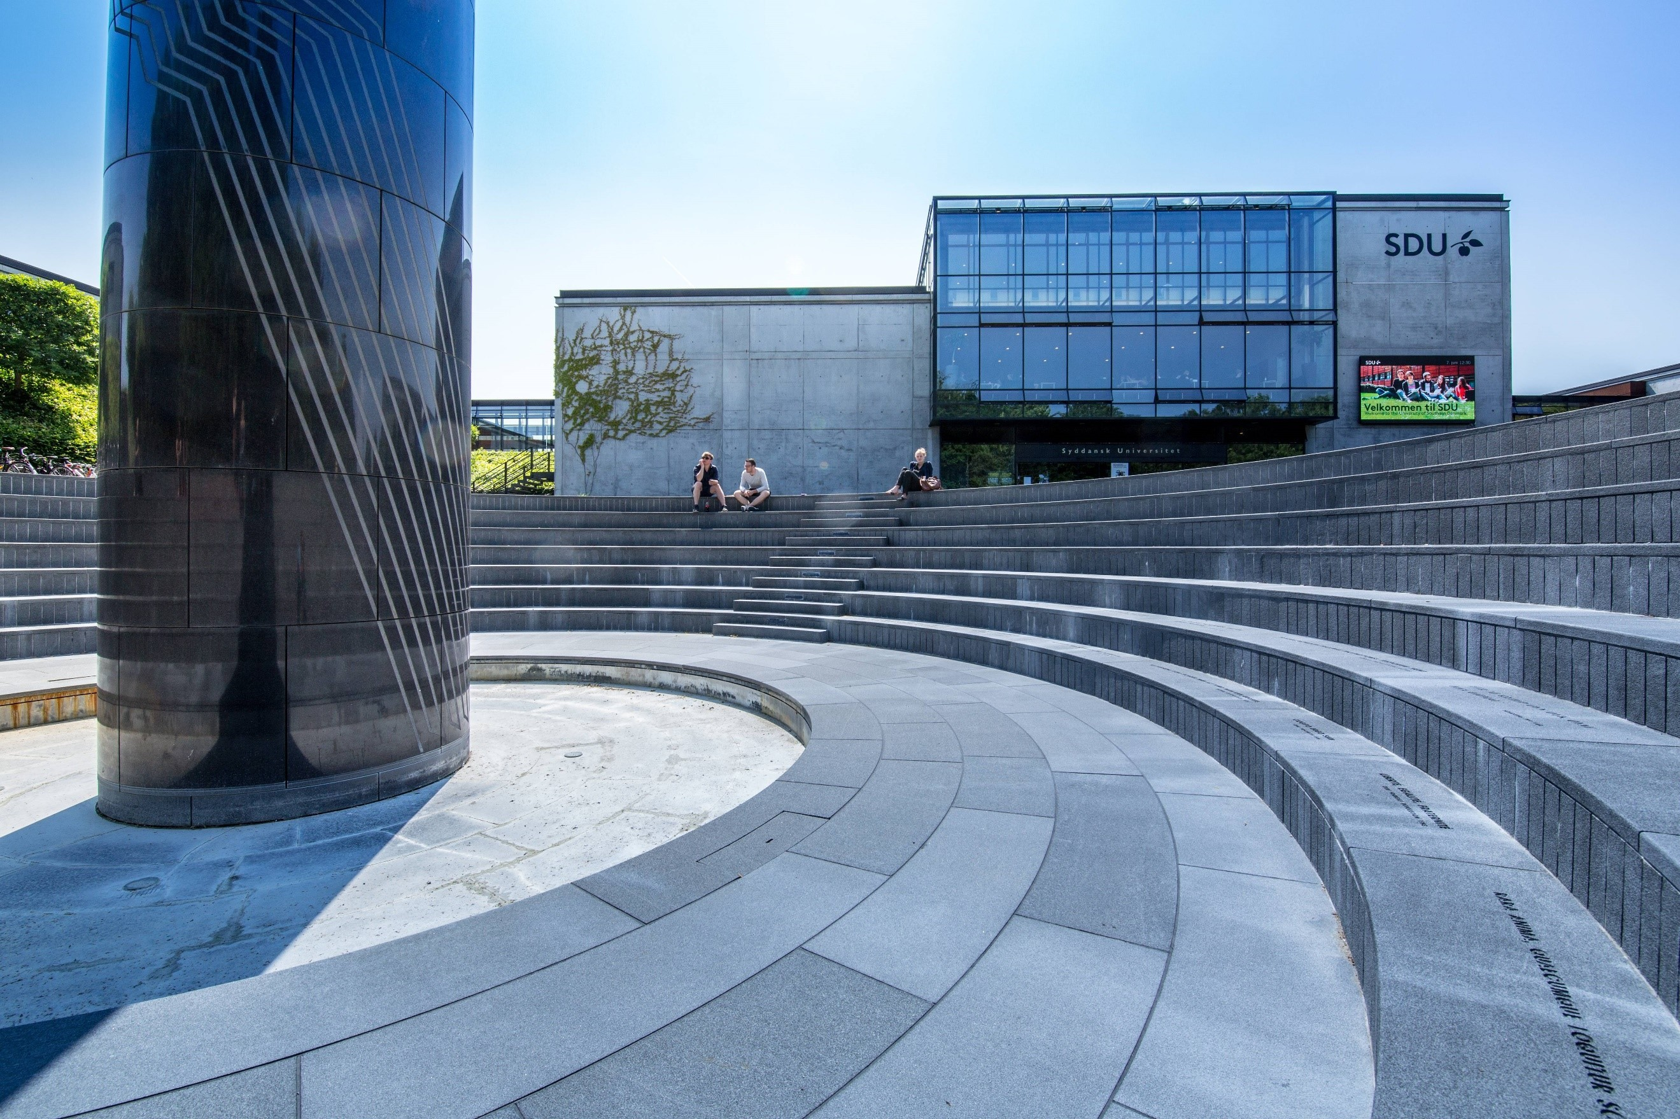
CITIZEN SCIENCE AT SDU
Citizen Science is often used for data collection and mapping of nature areas, but at SDU we see Citizen Science as more than that.
Citizen Science is about generating interaction and dialogue between citizens and researchers, thereby reducing the distance between them in order to encourage a debate based on knowledge and facts.
In Denm

Slide 18
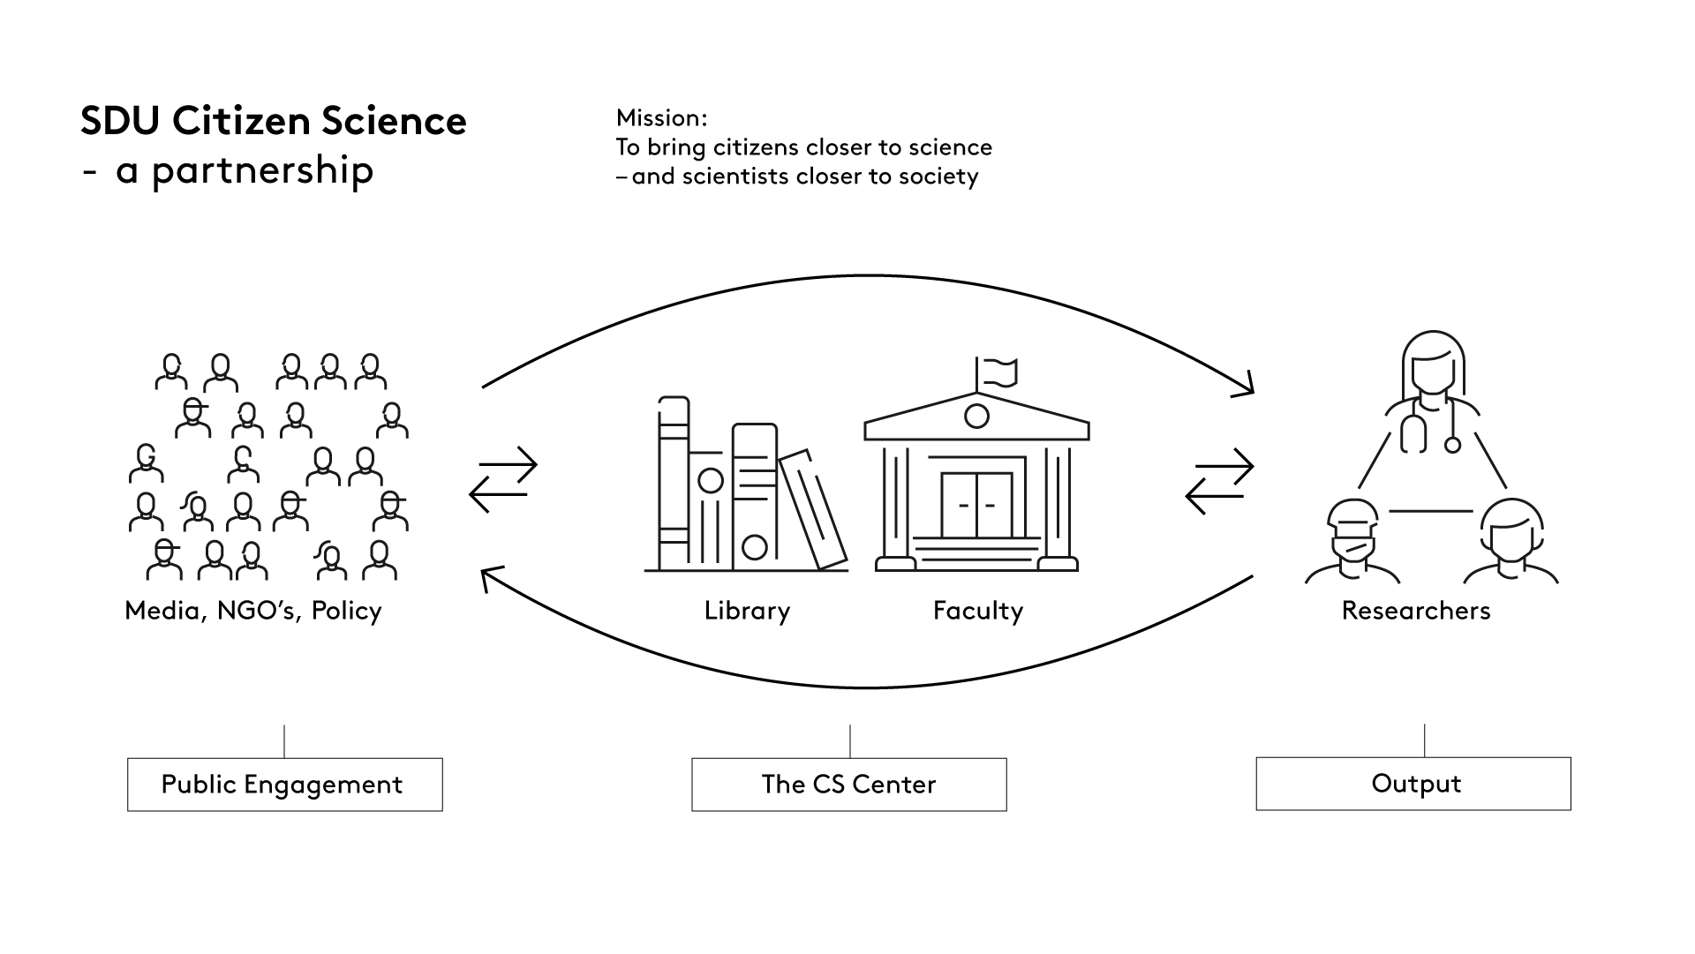

Slide 19
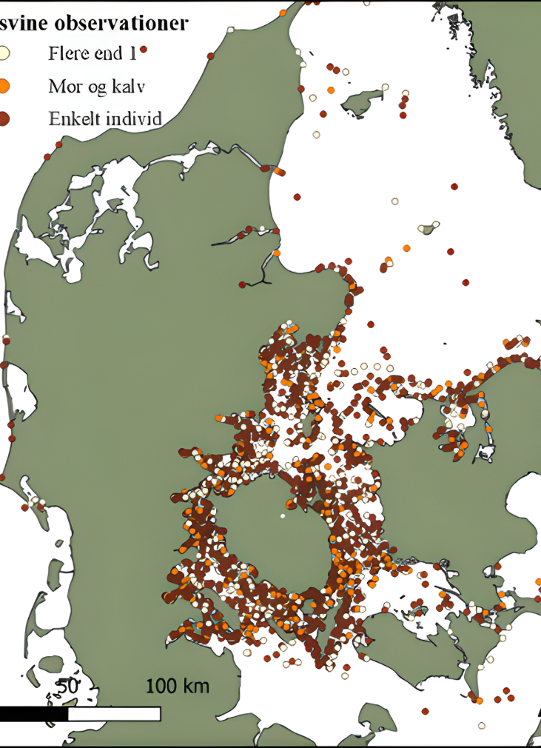
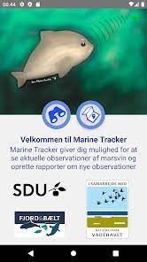
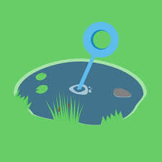
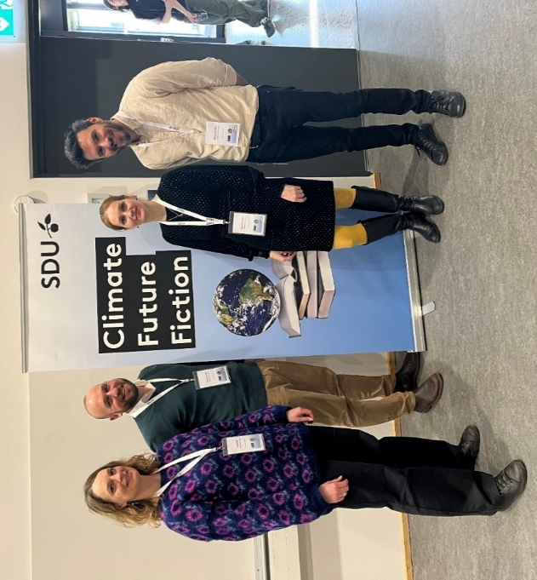
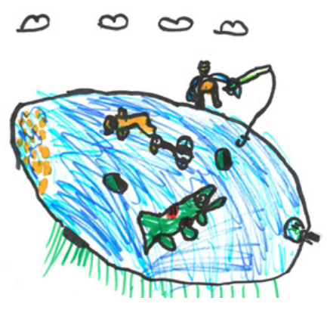
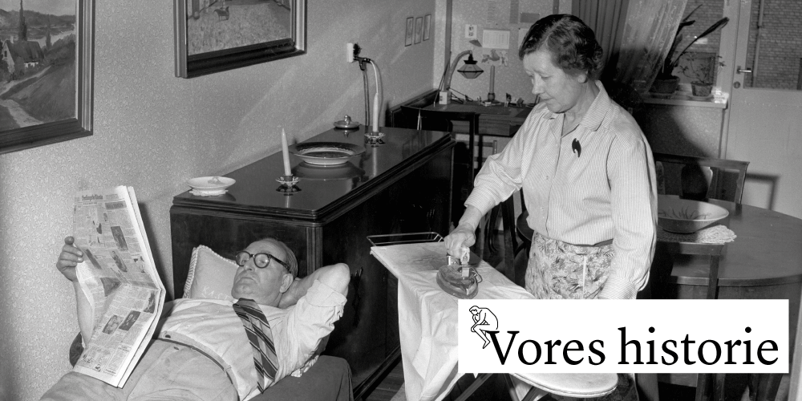
+35 CS-projects and their impact (reach 4 mio. citizens)
6.000 citizens collected 1.322 water samples and 12 camps for kids was held
75.000 citizens voted and prioritized health research in their region
More that 14.000 observations since 2018, data dissemination to ‘Arter.dk’
500 climate short stories and dialogue with 1.000 high school students are data
1.000 interviews from 4.000 high school students are data

Slide 20
RMA & Citizen Science Centre/Research Library
Pre /
RMA & Citizen Science Centre/Research Library

Slide 21
Workshop: Round 1 (Kloppenburg 2022)

Slide 22
Involvement in steps of a simplified research process
 | Identify problem | Research questions | Study design | Collect & process data | Analysis and interpretation | Involving stakeholders | Societal impact
Research libraries
Public libraries
NGO’s
Other

Slide 23
Workshop: Round 2 (Barriers & Accelerators)

Slide 24
Advice for the future? A shared statement on future role/use of CS from the workshop… (Drawing by Frits Ahlefeldt)

